Slide 1
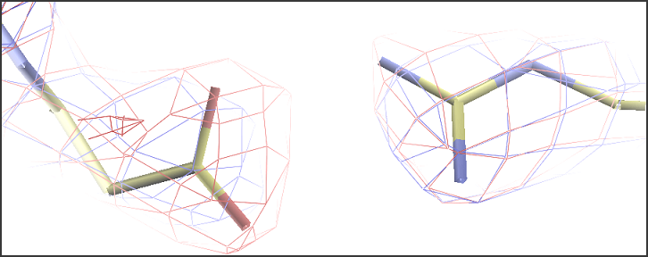
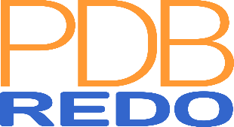
How good is my model?
And can it be improved?
Robbie P. Joosten
Netherlands Cancer Institute
CCP4-DLS school 2020

Slide 2
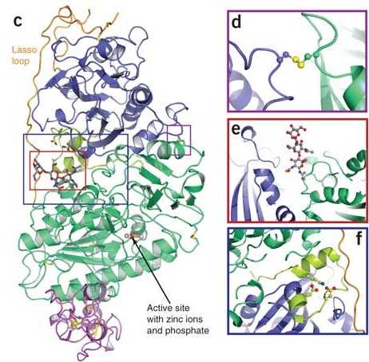
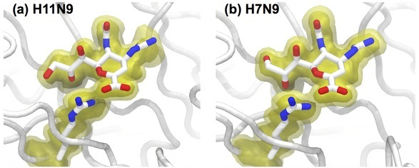
We want to know...
What are a protein’s function and mechanism?
How can we manipulate them?
We need the best possible model to answer these questions

Slide 3
Is my model as good as it can be?
Use validation when making the model
  Check model vs. data and vs. prior knowledge
  Focus on outliers (fix or explain them)
  Know the things that can go wrong
Optimise the model
  Focus on what can be improved
  Choose best refinement parameters and restraints
  Rebuild parts of the model
  PDB-REDO automates this

Slide 4
Validation

Slide 5



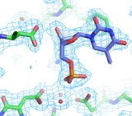
Need to know
Check the validity and value of a model
  Accuracy and precision
Many different software tools
  General: WHAT_CHECK, MolProbity, PDB validation server
  Non-protein: CheckMyMetal, Privateer, DNATCO
  Tools may check the same things differently
Not a substitute for common sense
  False positives do occur
  Conflicting results
  Not all problems are detected (explicitly)

Slide 6
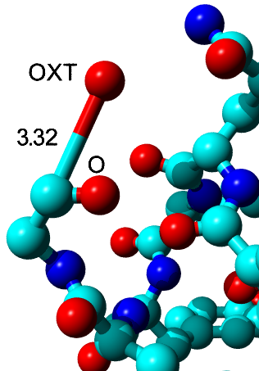
Bonds and angles
Individual outliers
  Usually fitting errors
  Express deviation in terms of SD (Z-scores)
  Example: Z = 105
Large overall deviations from ideal values
  Express as rmsZ, not rmsd
    Should be < 1.000
  Use tighter restraints

Slide 7
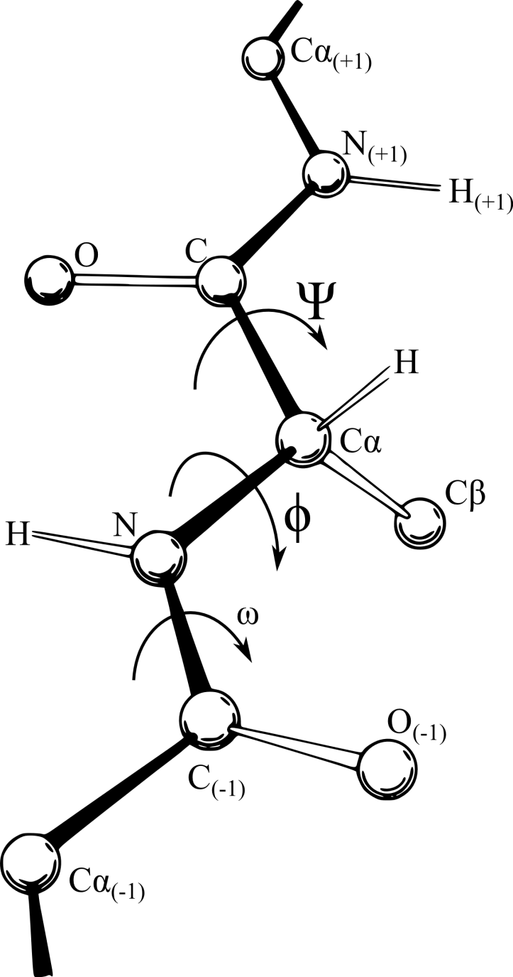
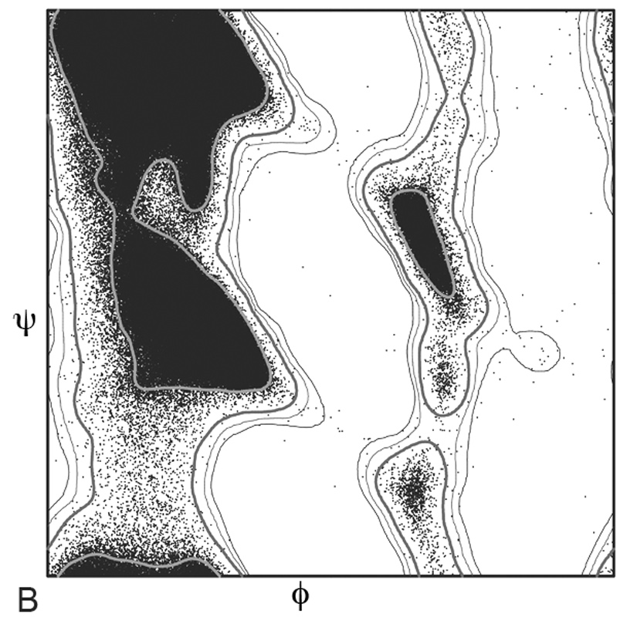
Backbone torsion angles
Ramachandran plot
  φ and ψ angles
  Compare to the whole PDB or a subset
Different implementations
  MolProbity and COOT: preferred, okay, outlier
    Good for finding specific problems
  WHAT_CHECK and Tortoize: overall Z-score
    Good for checking building and refinement progress
    Now also reported by MolProbity

Slide 8
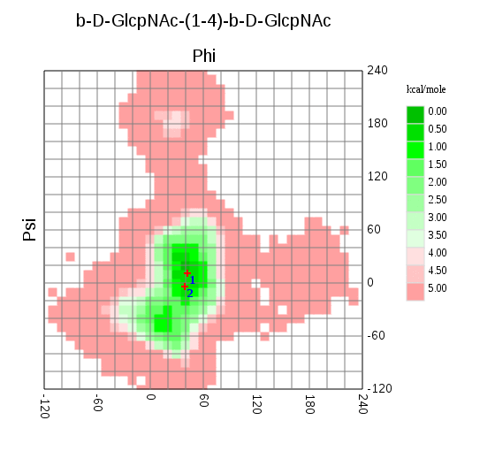
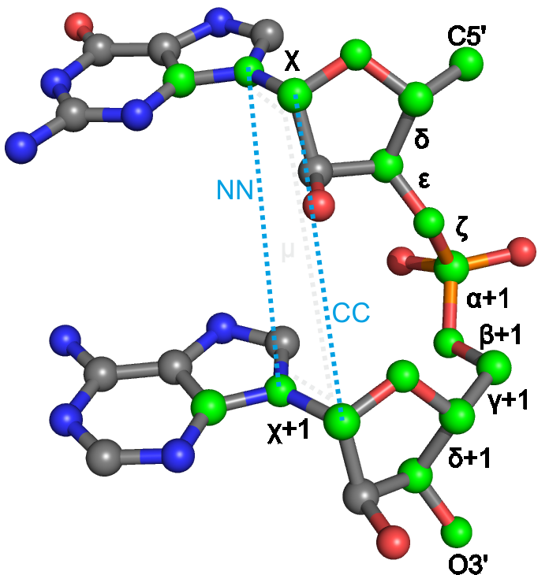
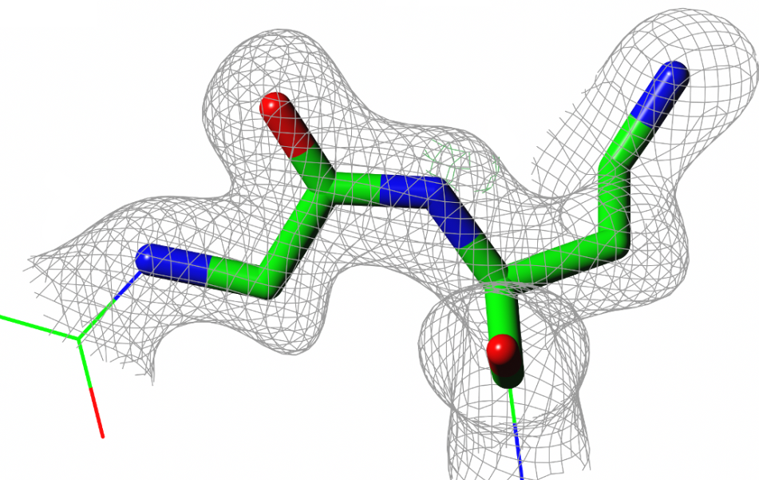
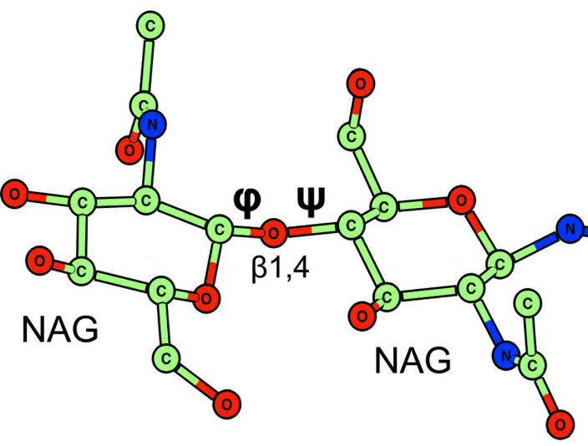
Backbone torsion angles
Peptides are flat
  ω angle is ~180° (trans) or ~0° (cis)
  Fitting errors or the wrong restraints cause outliers
Ramachandran-like validation for non-proteins
  Nucleic acids in DNATCO
    CONFAL: 2-residue conformers
  Sugars in CARP
    sugar-sugar bond specific

Slide 9
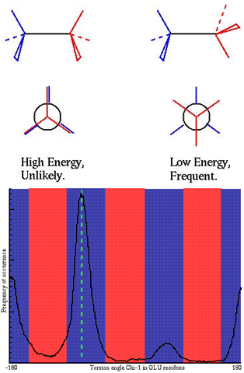
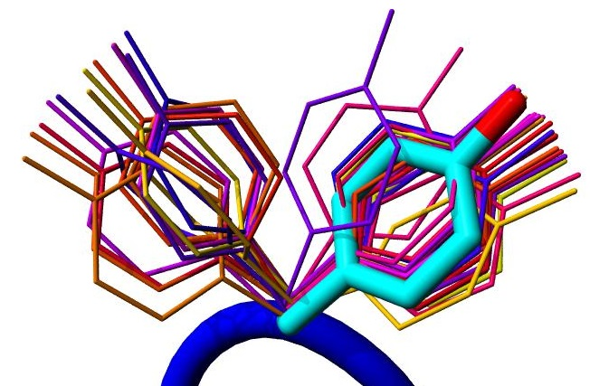
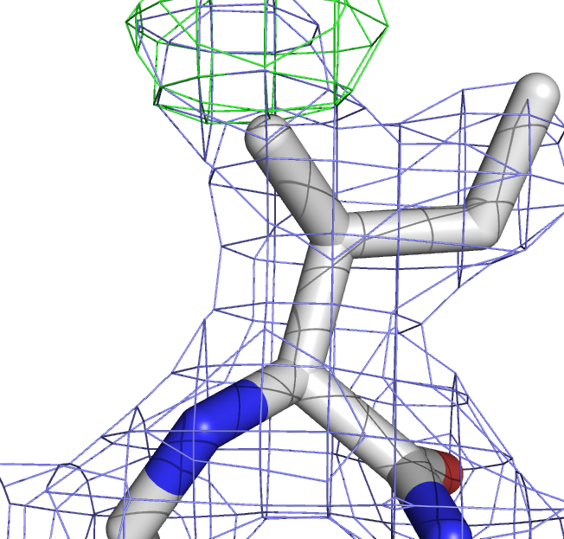
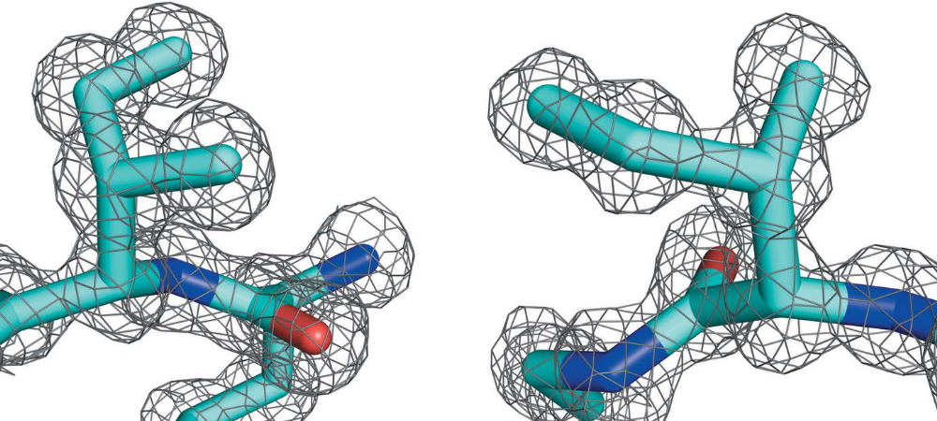
Side chain torsion angles
Steric hindrance causes discrete rotamers
Check against (backbone specific) distributions from the PDB
Outliers are fitting errors or false positives

Slide 10
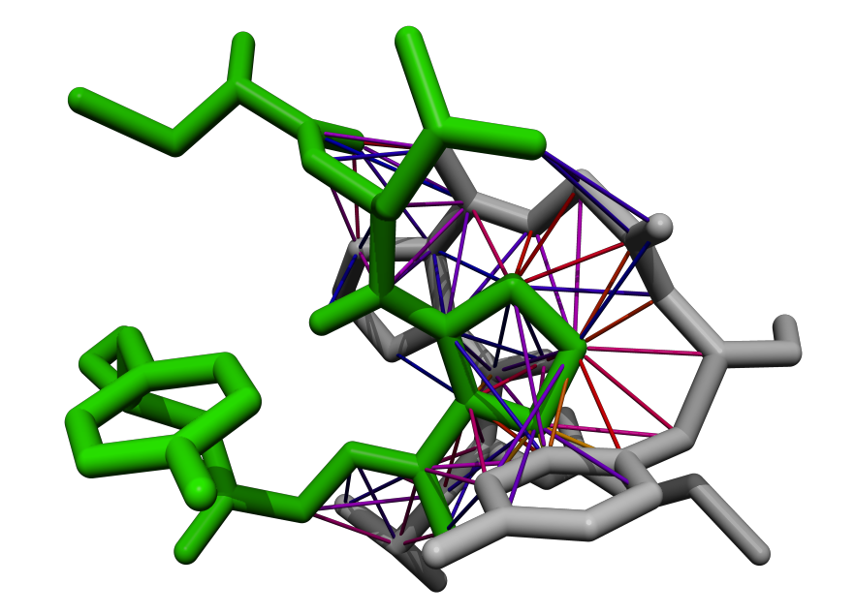
Bumps
Two atoms cannot occupy the same space
Average PDB file > 100 bumps
Bumps vary in severity
  Mild bumps can be fixed by refinement
  Severe bumps typically require rebuilding
Don’t forget about symmetry
Normal contact Mild bump Severe bump

Slide 11
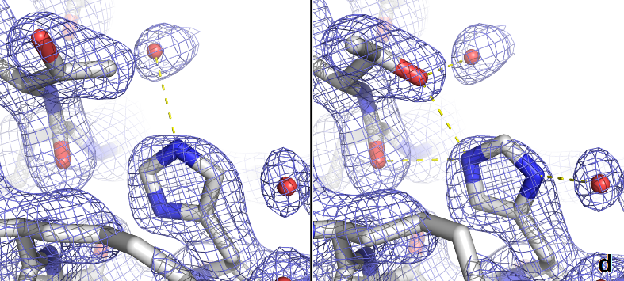
Hydrogen bonds
Asn, Gln, and His flips
  Detected by WHAT_CHECK, MolProbity & COOT
  Also use common sense
Buried unsatisfied H-bond donors and acceptors mark (subtle) errors
  Use environment distances in COOT
Waters should also make H-bonds
  3b3q has > 250 waters without H-bonds

Slide 12
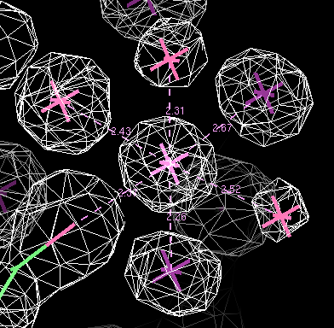
Metal ions
Light metal ions are easily overlooked
  Water, Na+, and Mg++ have same number of electrons
Detect and validate with COOT, Phenix, CheckMyMetal
  All use the Bond Valence method
  Depends on coordination distances
  Very different results

Slide 13


Metal ion validation
Use anomalous maps
Use wavelength scan from synchrotron
Keep your crystallisation conditions in mind
Check site geometry with in MetalPDB
If it is really important, do more experiments

Slide 14
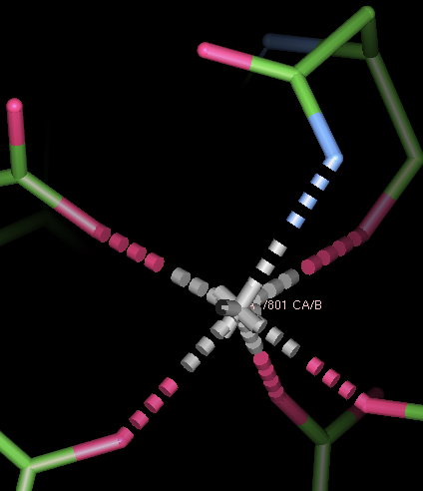
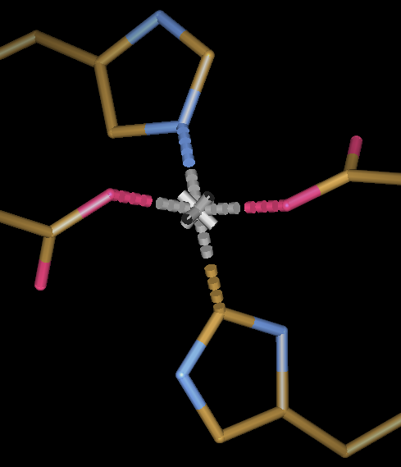
Metal ions
Na, Mg, K, Ca prefer being coordinated by oxygen atoms
  Flip Asn or Gln side chains if needed
Carbons usually do not coordinate metals
  Flip His side chains if needed
  Cyanide and carbon-monoxide are exceptions
Notes:
pdb1hfe.ent:LINK CE1 HIS S 82 ZN ZN S 500

Slide 15
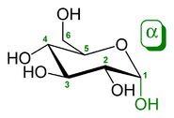
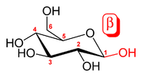
Sugars are complicated
Small differences matter for biology/biochemistry
Maps are often difficult to interpret
Coordinates and residue name must match sugar identity
  Or your refinement will go wrong
Bonds between sugars are common
  Mostly from C1 to an oxygen (O1 is lost)
  Original position of the O1 describes the linkage type (α or β)

Slide 16
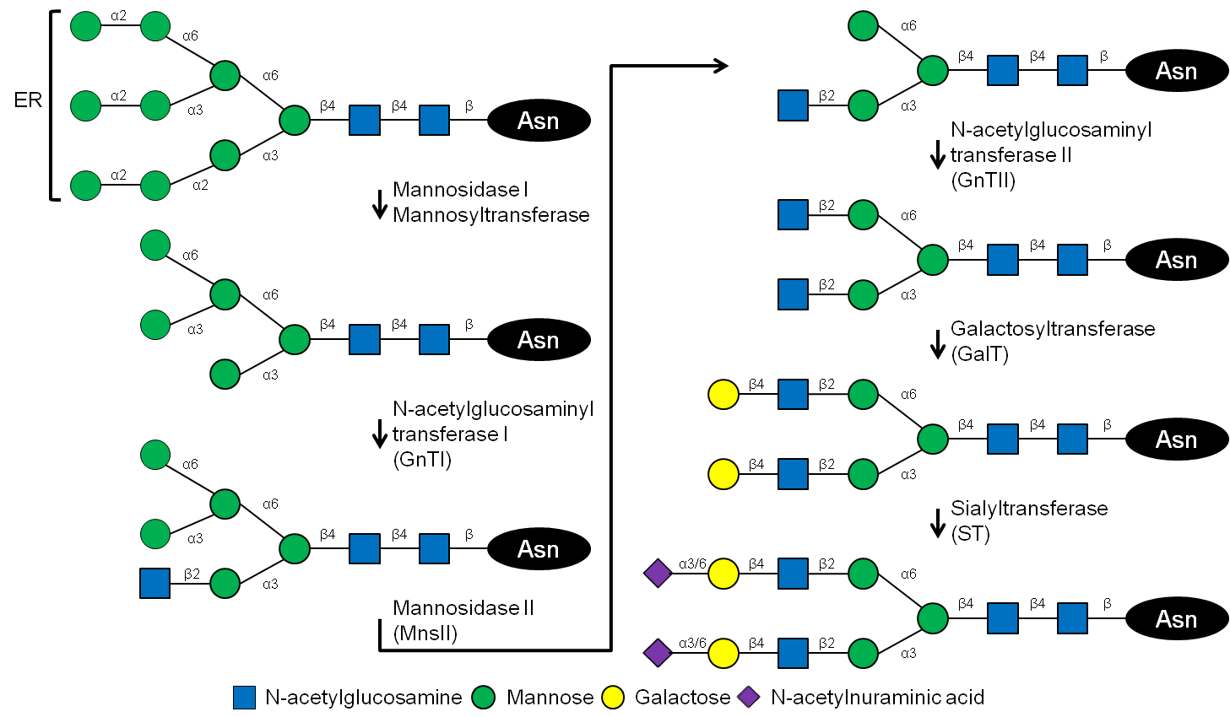
Sugar validation
PDB-care validates nomenclature and connectivity based on atom coordinates and biological pathway
Privateer checks conformations

Slide 17
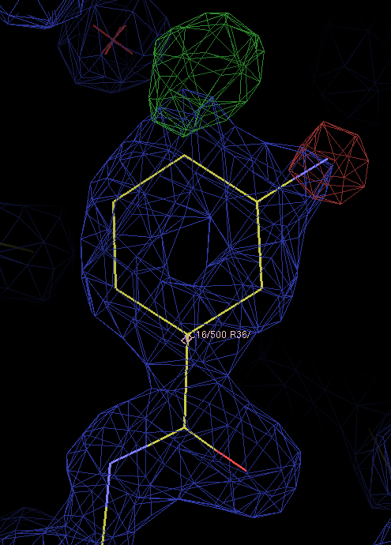
Ligands
Building and validation steps:
Is something there?
  Check the (difference) density
Is it my ligand?
  Check contacts
  Remember crystallisation conditions
  Check the density in detail
Is the geometry sensible?
  Check against restraints
  Check against small molecules
  Check the restraints themselves

Slide 18
Validation is a lot of work, but it helps you make better models

Slide 19
Model optimisation
Refinement settings
  Restraints and weights (geometry, B-factors, homology, jelly body)
  Solvent model
  High resolution cut-off
  Special cases (NCS, twinning, occupancies)
Number of model parameters
  B-factor model
  Number of TLS models
Structure model
  Main chain
  Side chains
  Hetero compounds
Automation speeds up optimisation

Slide 20
PDB-REDO
Pipeline for X-ray & electron crystallography
  Fully automated expert system
  Refines, rebuilds, and validates your model
Well-tested and high-throughput
  Run on the entire PDB
  Databank with weekly updates (pdb-redo.eu)
Available as webserver & installable software
  >1900 active users
Model, X-ray data, sequence
Parametrisation
REFMAC refinement
Rebuilding
REFMAC refinement
Model validation
PDB-REDO model and data

Slide 21
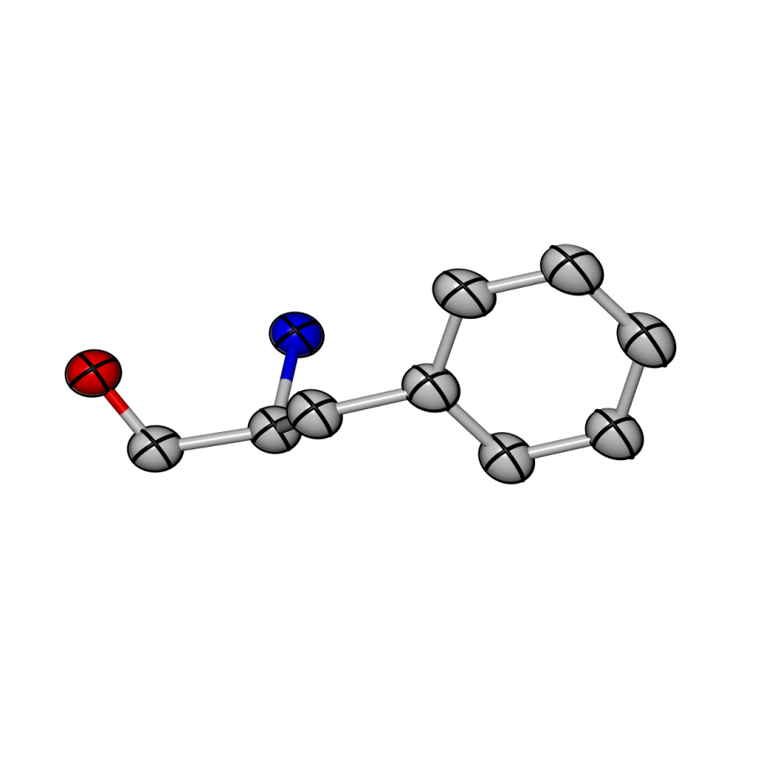
Features and algorithms
Methods
NCS and twinning treated automatically
  Warns for space group errors
Establish high resolution cut-off through paired refinement
B-factor model selection:
  Refine alternative models and select best one
    Isotropic, anisotropic, or flat B-factors
    One TLS group per chains, user-provided model, or no TLS
Grid searches:
  Optimise solvent mask parameters
  Select weights for geometric and B-factor restraints

Slide 22
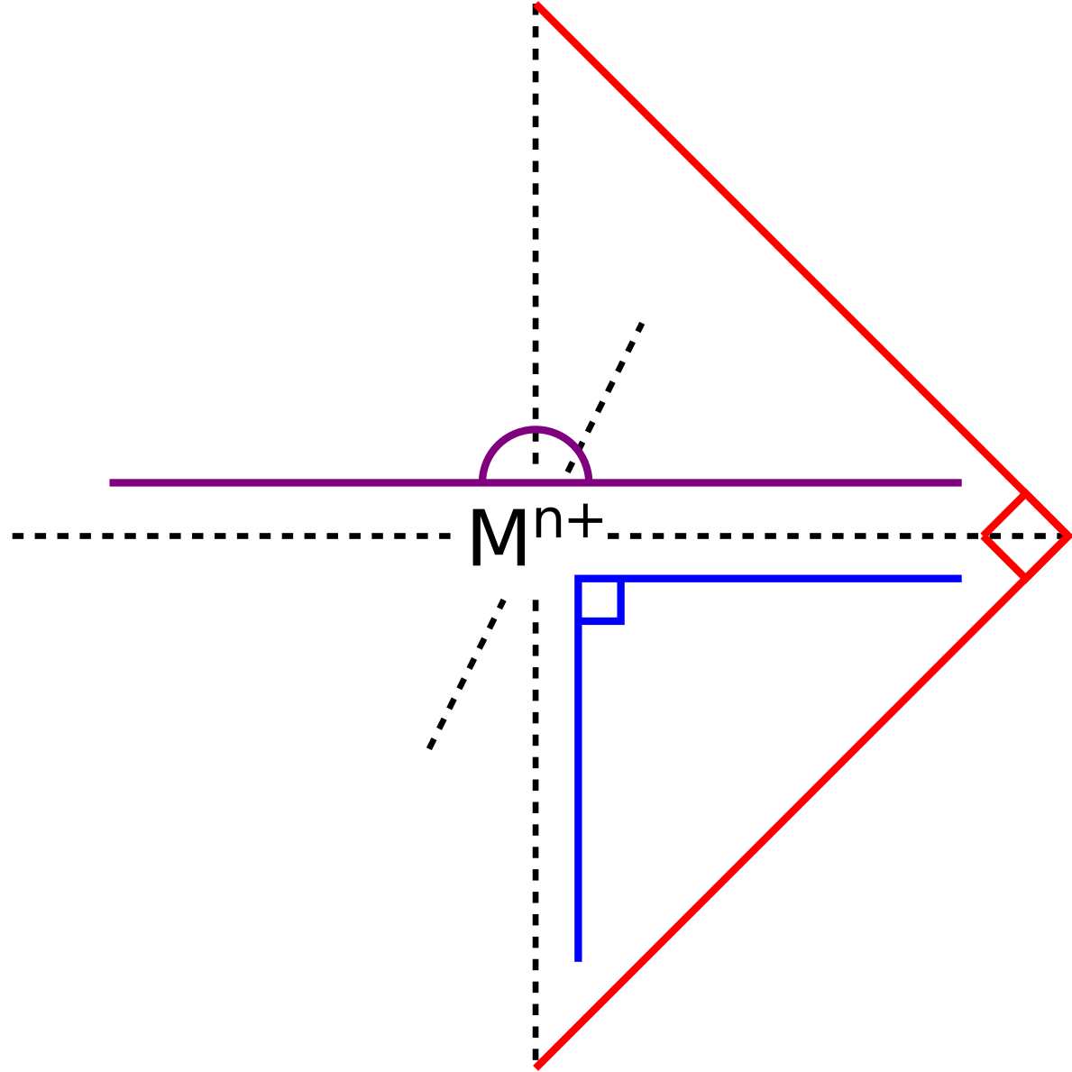
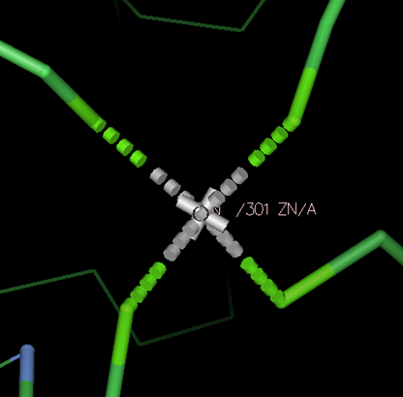
Features and algorithms
Methods
Case specific restraints:
  Jelly-body restraints (low resolution)
  Harmonic position restraints (small datasets)
  Zinc sites (all structural zinc sites)
  Octahedral Sodium and Magnesium sites
    Can only be distinguished by coordination distance
    Distance biased by restraints, but restraints are needed
    Solution: use alternative angle restraints
      Created by platonyzer
      18 angle restraints per site, no distance or VdW restraints

Slide 23
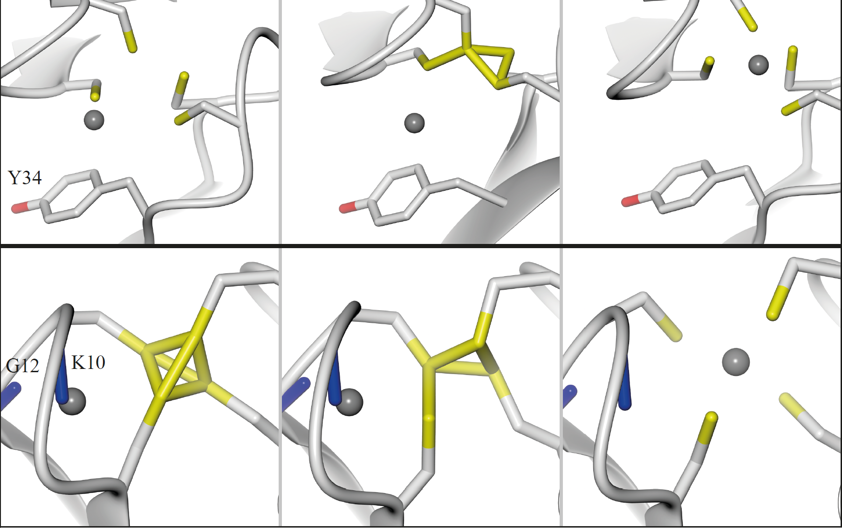
Added value of Platonyzer
Theory
PDB
PDB-REDO
PDB-REDO & platonyzer
Notes:
Resolution indirect measure of amount of data

Slide 24
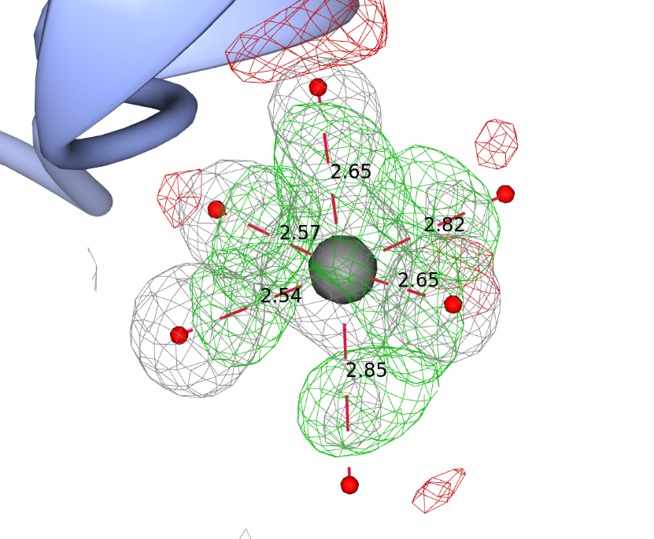
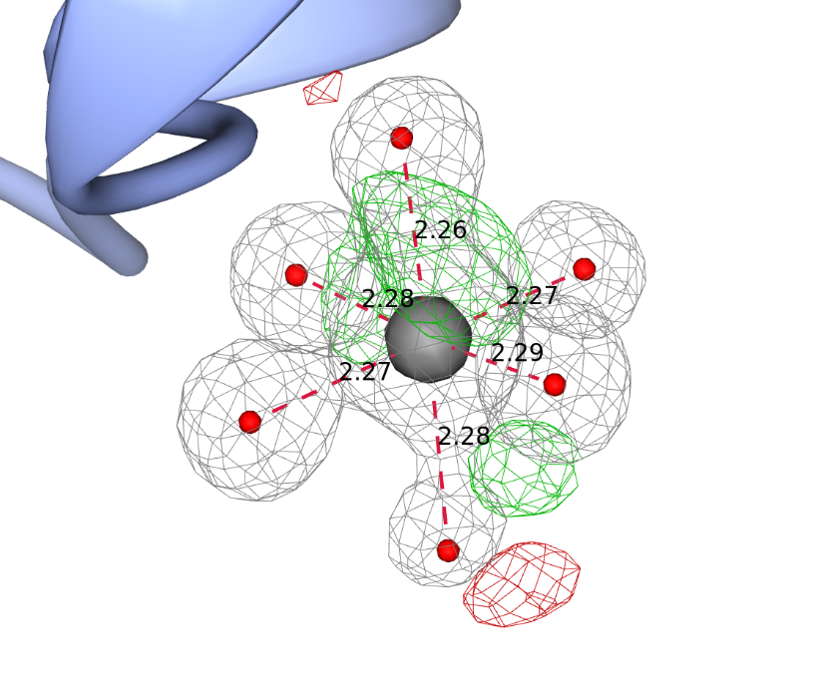
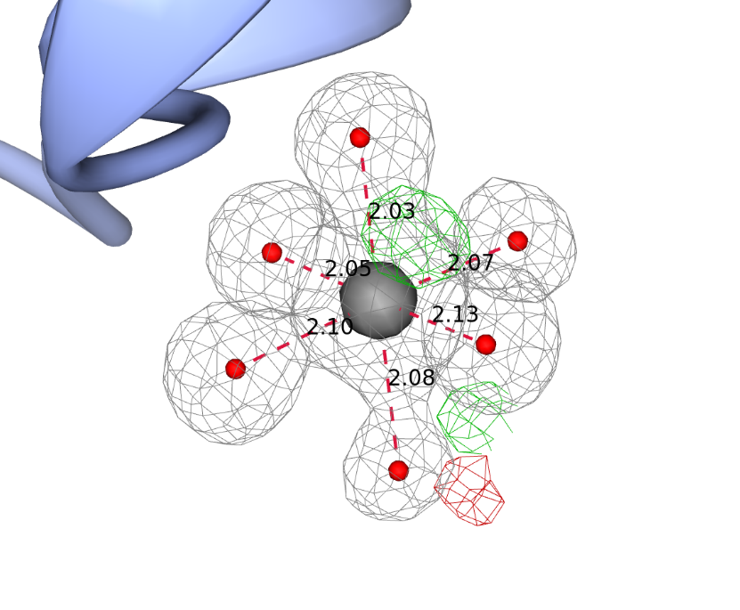
Added value of octahedral restraints
Magnesium site with sodium modelled becomes Mg-like
  Opposite can happen as well
PDB
PDB-REDO
PDB-REDO + platonyzer

Slide 25
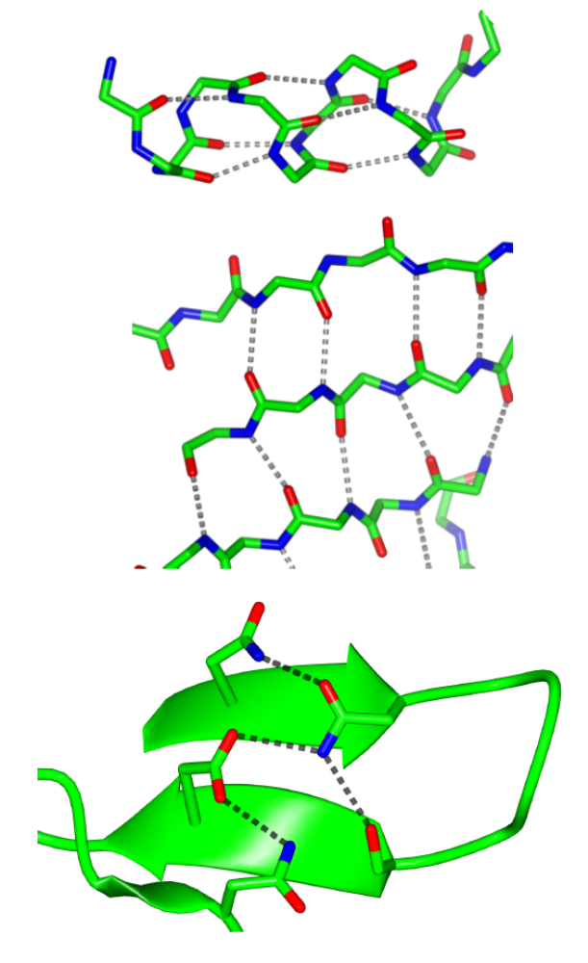
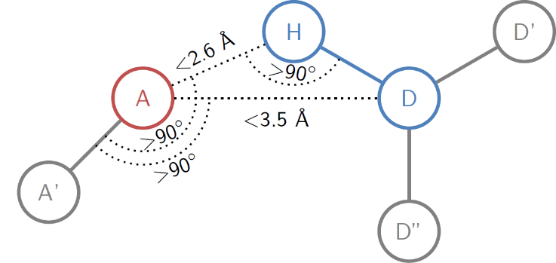
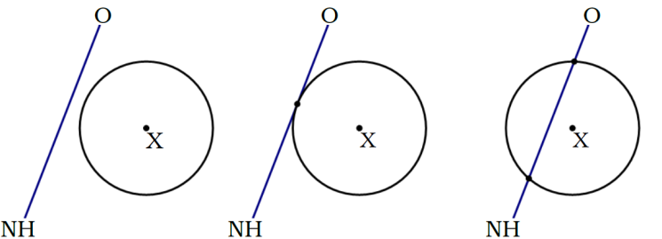
Homology-based H-bond restraints
H-bonds are real ‘long-distance’ interactions
  Can be used as distance restraints
Omnipresent in protein structures
  Enough extra information
  Side-chain H-bonds are very structure specific
We know what they should look like
  Detect and filter real H-bonds

Slide 26
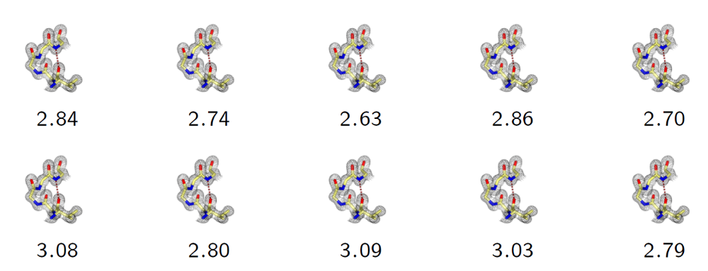
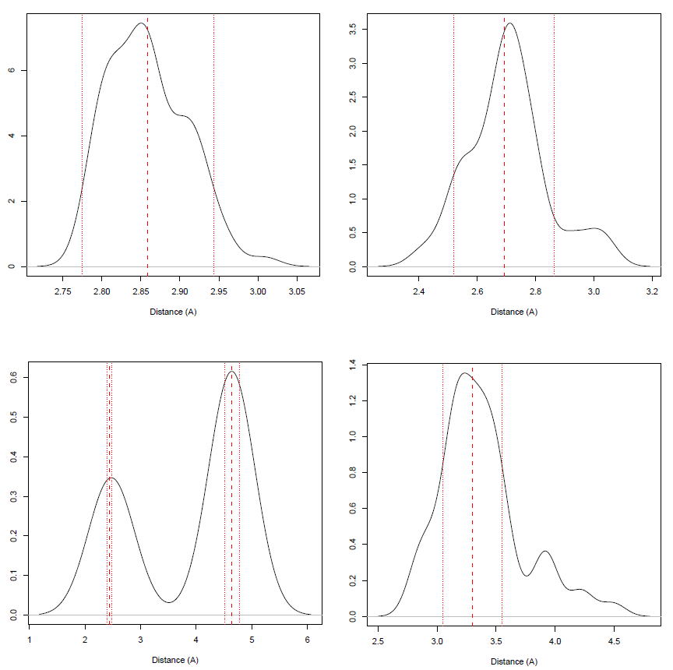
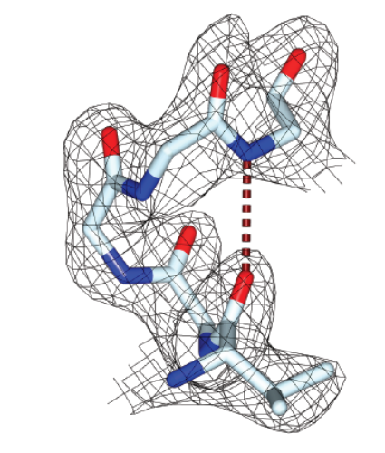
HODER: HOmology-DErivid Restraints
BLAST model sequence against PDB-REDO db
  Use models with sequence identity > 70% and resolution ≤ model
Find equivalent H-bonds in homologs
  Filter: same secondary structure
  Filter: same side-chain rotamer
If > 5 distances, fit target and SD
  Higher SD, lower relative restraint weight
Works for 82% of protein-protein H-bonds
  Fallback to 97 types of atom and secondary structure specific H-bond restraints
  Mined from 10k high quality structure models
    3.7 million observations

Slide 27
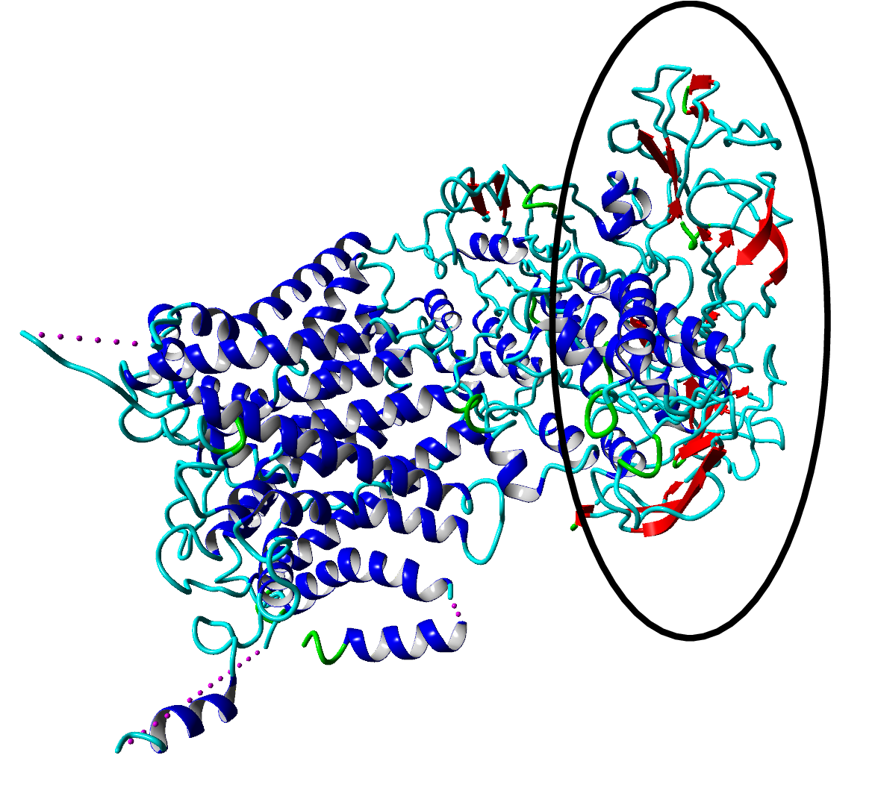
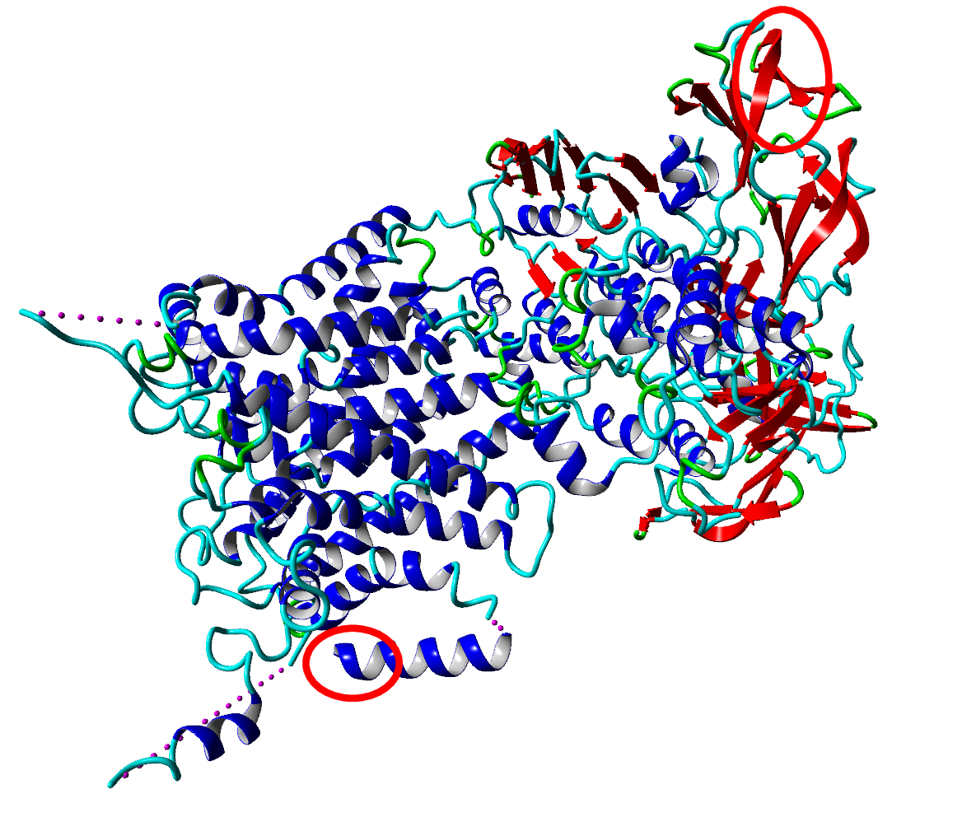
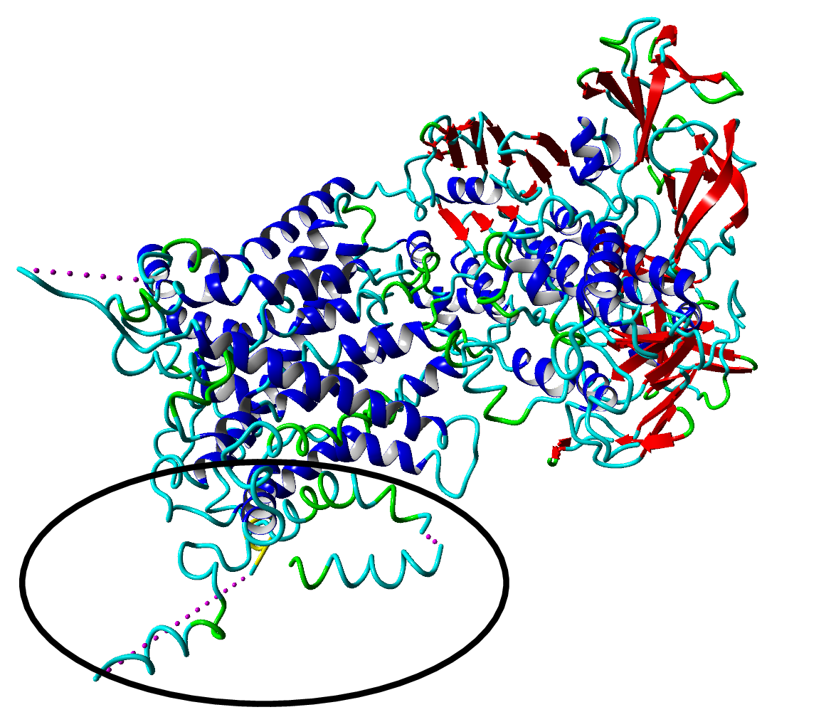
Added effect of homology restraints
Theory
E. Coli maltose transporter (3fh6, 4.5Å)
PDB-REDO new
PDB
PDB-REDO
Notes:
R-free 37.7 > 33.9

Slide 28
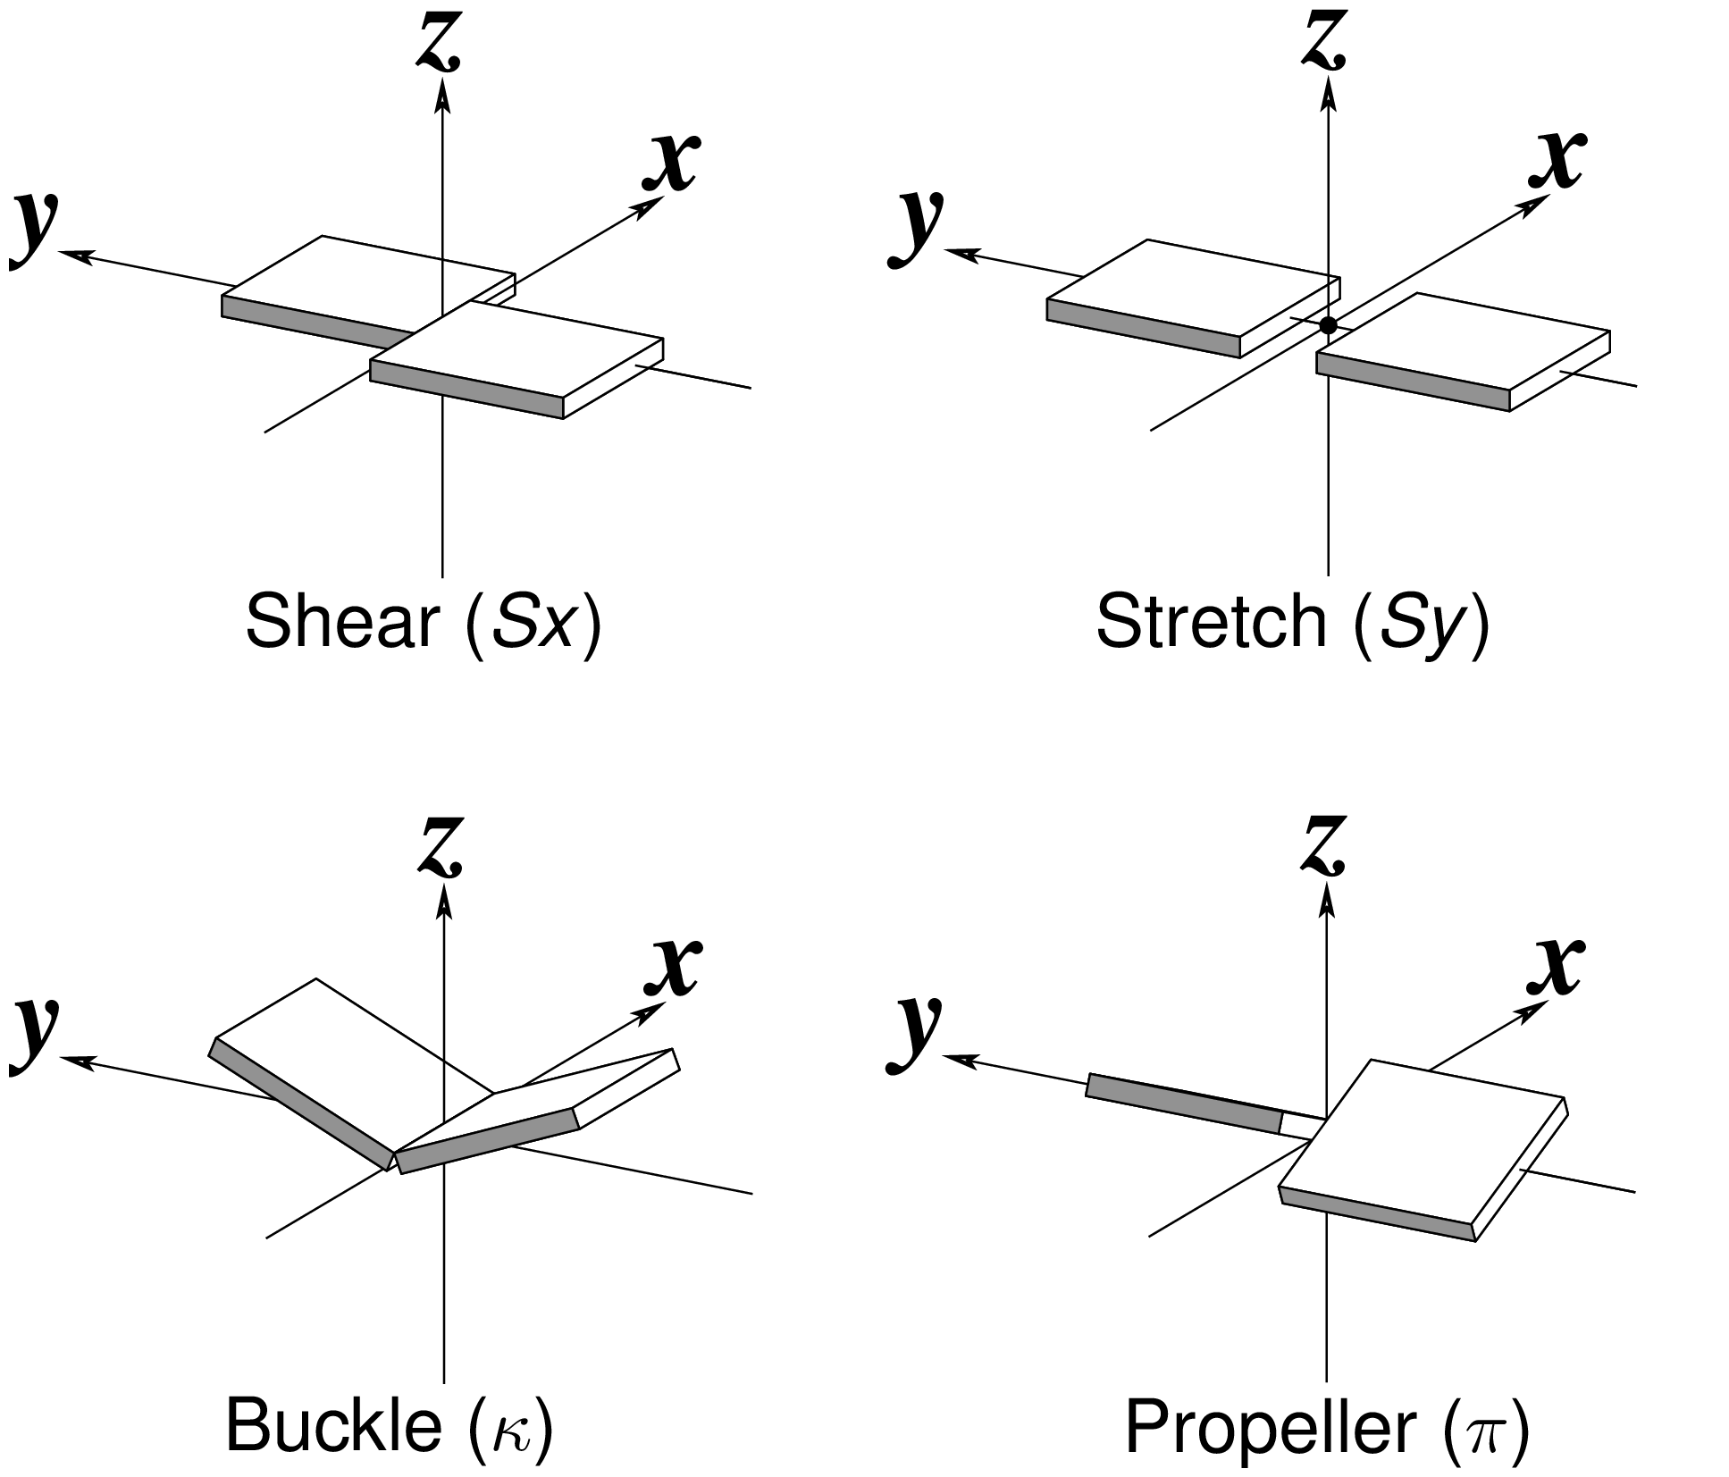
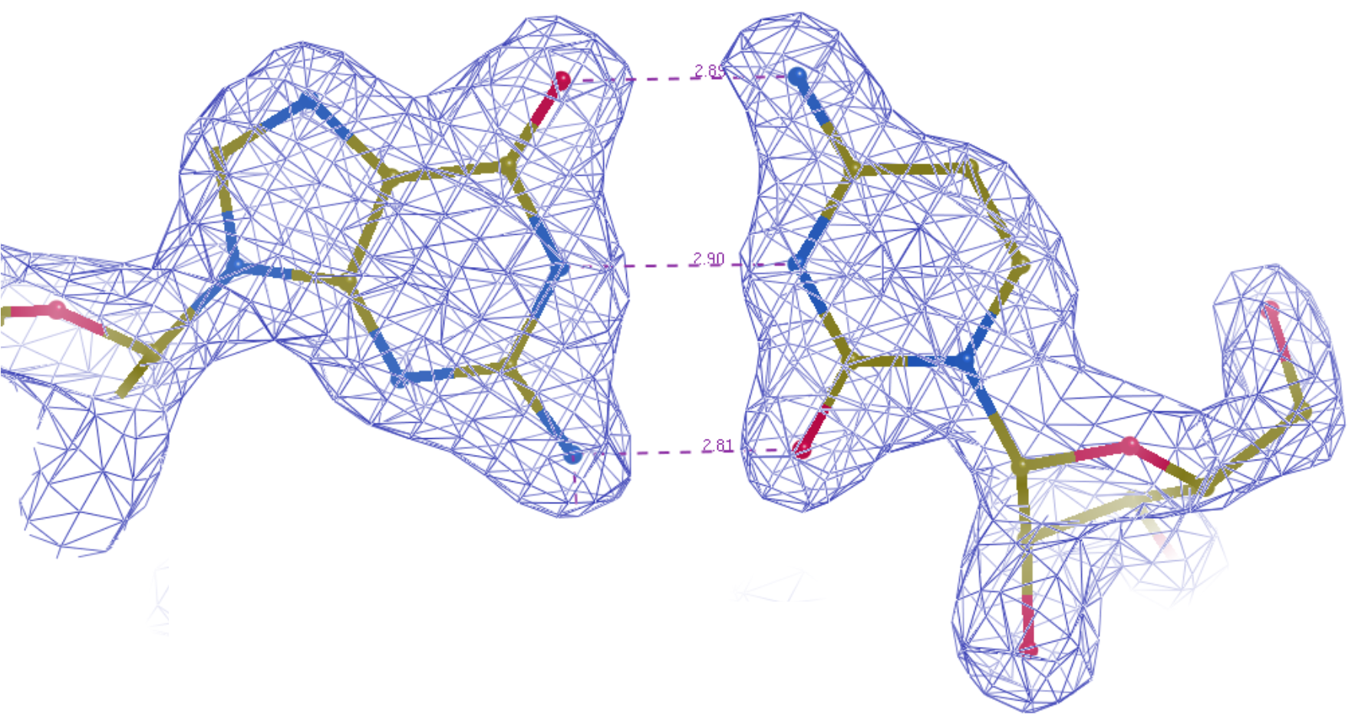
Nucleic acid features
Restraints for H-bond distances in WC base pairs
  Targets mined from high-res PDB-REDO entries
Torsion and stacking restraints from LibG
Geometric validation
  Base pair geometry normality
  Confal scores from DNATCO
  Not yet in the visual output

Slide 29
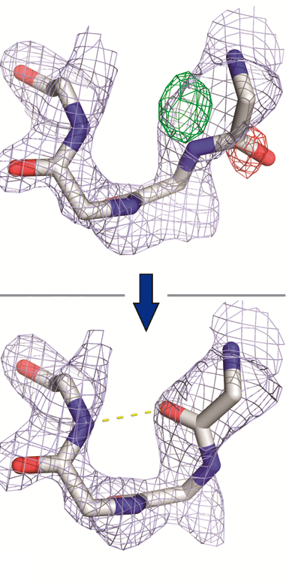
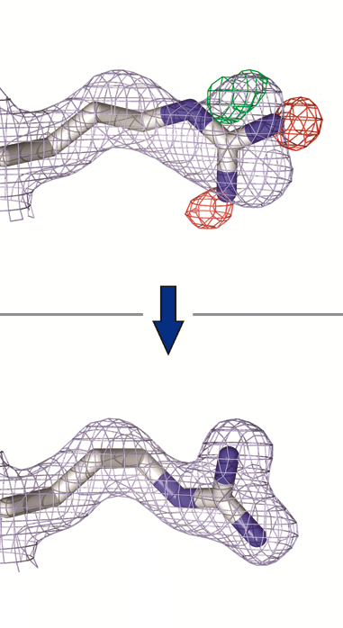
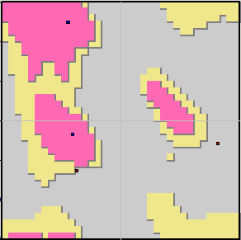
Model rebuilding
Methods
Peptide flipping:
  If a flip improves density fit and Ramachandran plot: accept flip
Side-chain rebuilding and completion:
  Add missing side-chains, rebuild existing ones, flip His/Asn/Gln if needed

Slide 30
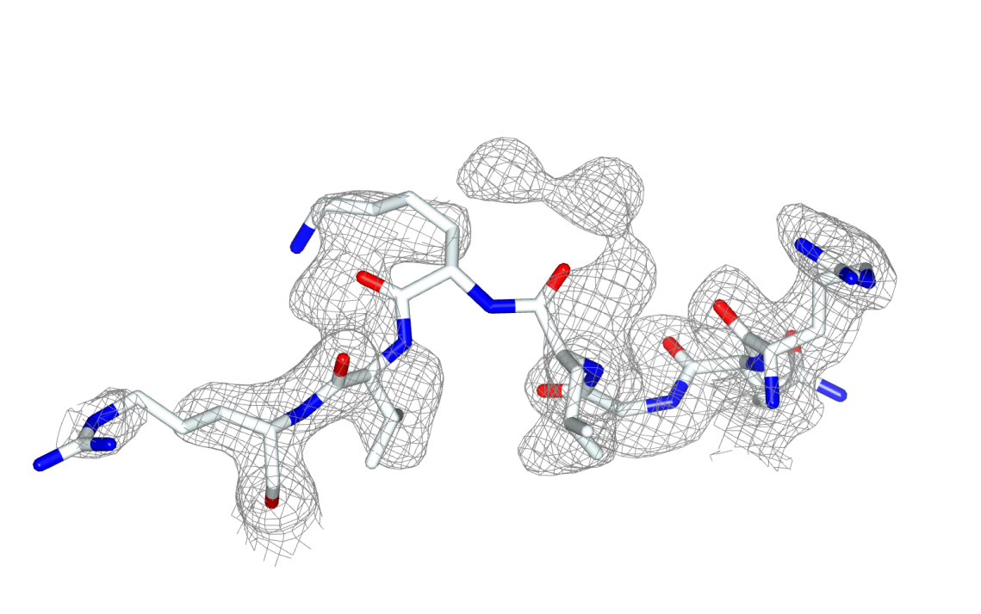
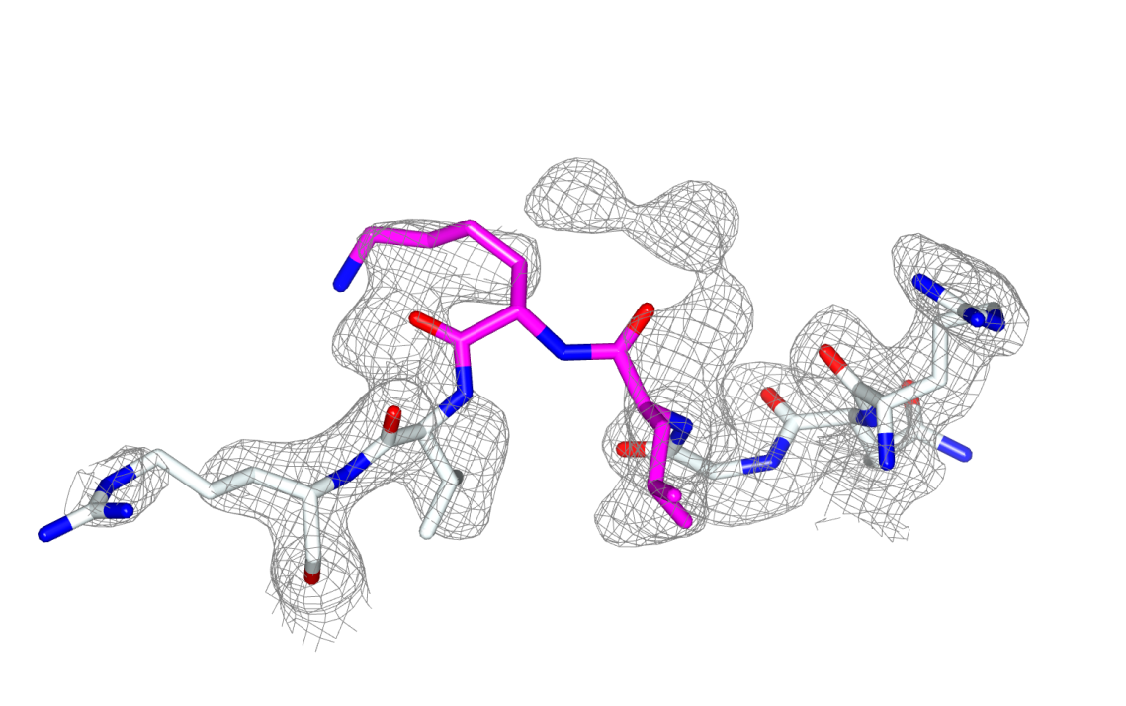
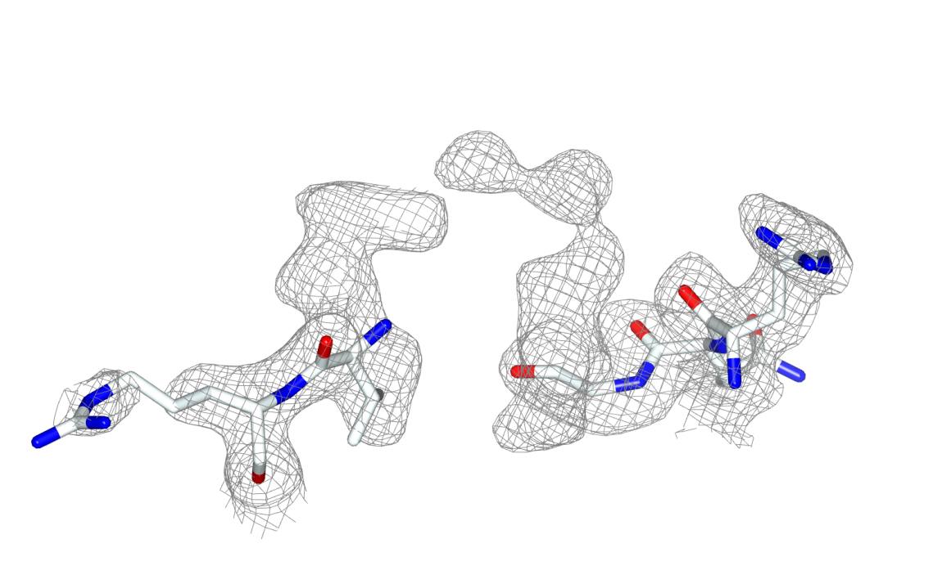
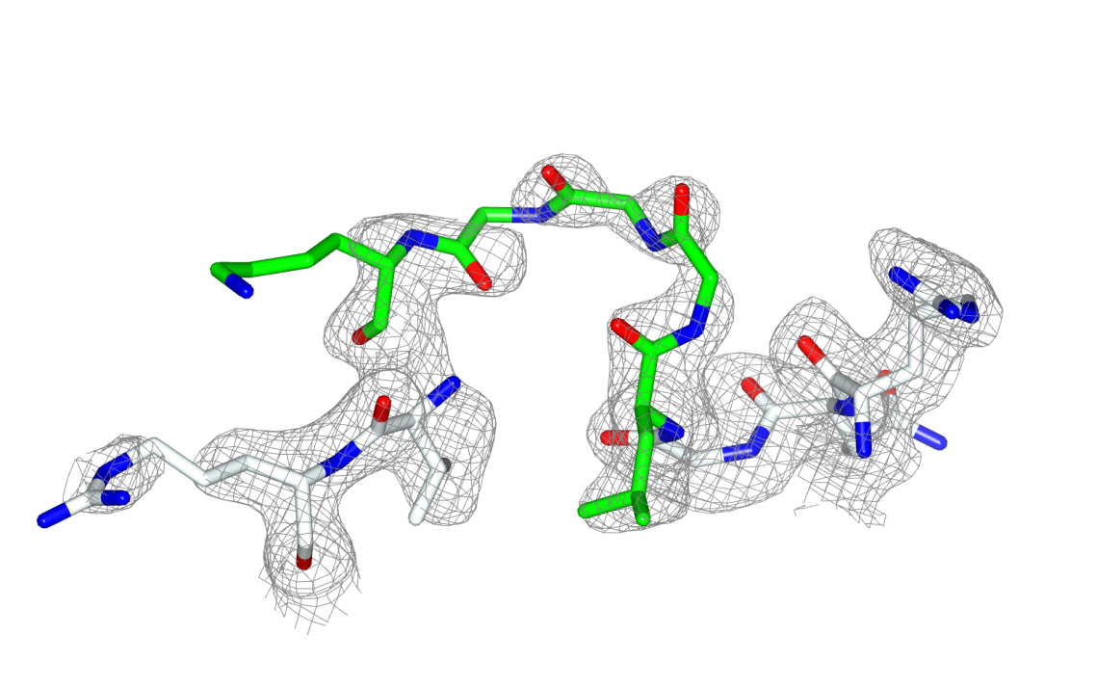


Homology-based loop building
Loopwhole adds missing loops by homology
Find missing loop based on sequence
Find homologous structures with the loop present
Prepare for loop transfer
For all homologous loops:
  Transplant the loop to target model
  Refine with coot-mini-rsr
Keep the best loop if it is good enough
  Filter on structural quality and map fit

Slide 31



Real-life example
Theory
β-glucosidase (3abz, 2.2Å)
Notes:
3abz Beta-glucosidase (14 residues added)

Slide 32






Automated N-glycan handling
Methods
Carbivore and COOT N-glycan building
Rebuild glycan trees with poor geometry
  Either biologically wrong sugars or residues marked by Privateer
Extend existing trees
  Delete waters that are in the way
Build trees from scratch
  Detect possible glycosylation sites from sequence (N-x-[TS])
Validate on density and geometry

Slide 33


Validation
Methods
Before-and-after scores for:
  Geometry: packing, rotamers, Ramachandran plot, H-bonds, bumps
  Density fit: per-residue RSR, RSCC, EDIAm and OPIA
  Ligands: density fit, interactions and Heat-of-Formation
 | PDB | REDO
RSCC | 0.91 | 0.96
Bumps | 22 | 5
H-bonds (kJ/mol) | -70 | -95
HoF (kJ/mol) | 11817 | 322

Slide 34



PDB-REDO redone (n=100k)
Theory

Slide 35



PDB-REDO webserver
Password protected accounts
  Or use ARIA SSO or local login
  >1900 active users
Dashboard with previous jobs
  Summary sliders
Submit model, MTZ, sequence
  Restraints are optional
  6800 jobs submitted in 2020
  Jobs take ~45 mins

Slide 36
PDB-REDO output
Output
New model + new map coefficients
Tools to continue working on the structure model
  Optimised settings for refinement in REFMAC
  Already refined TLS model
  Ready-made extra restraints
Description of model changes
  At the local and the global level
  Visually oriented: colour coding, plots, visualisation script for COOT

Slide 37




Output

Slide 38

Herceptin – HER2 interface
After PDB-REDO:
R-free from 31.6% to 26.7%
  7σ improvement
Moved from 34th to the 99th quality percentile in MolProbity
Notes:
7 sigma improvement
Changes a30 A31 (herceptin) C602 C596 (HER2)
34th %-ile to
1n8z

Slide 39


Herceptin – HER2 interface
PDB
PDB-REDO
Notes:
7 sigma improvement
Changes a30 A31 (herceptin) C602 C596 (HER2)

Slide 40
Using PDB-REDO is little work, but it helps you make better models

Slide 41







Acknowledgements
Ida de Vries
Maarten Hekkelman
Krista Joosten
Anastassis Perrakis
Gert Vriend
Coos Baakman
CCP4 developers
PDB annotators
Garib Murshudov
Paul Emsley
Rob Nichols

